Slide 1
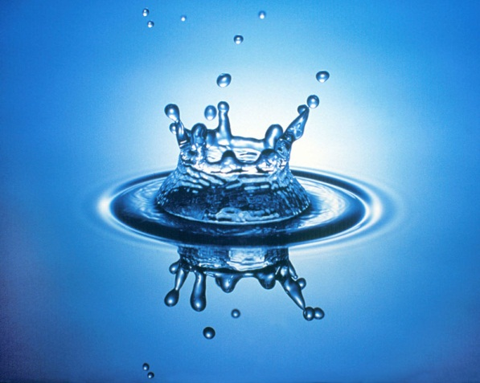
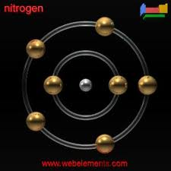
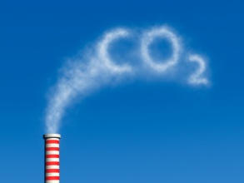
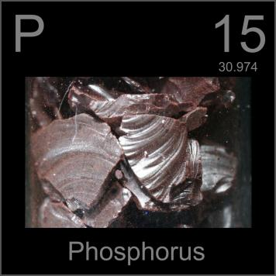
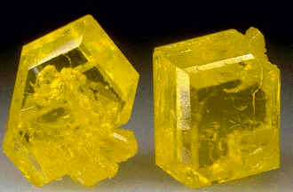
Biogeochemical Cycles
Water
Nitrogen
Carbon Dioxide
Phosphorus
Sulfur

Slide 2
Biogeochemical Cycle :
chemical elements are required by life from the living and nonliving parts of the environment.
These elements cycle in either a gas cycle or a sedimentary cycle
In a gas cycle elements move through the atmosphere.
Main reservoirs are the atmosphere and the ocean.
Sedimentary cycle elements move from land to water to sediment.

Slide 3
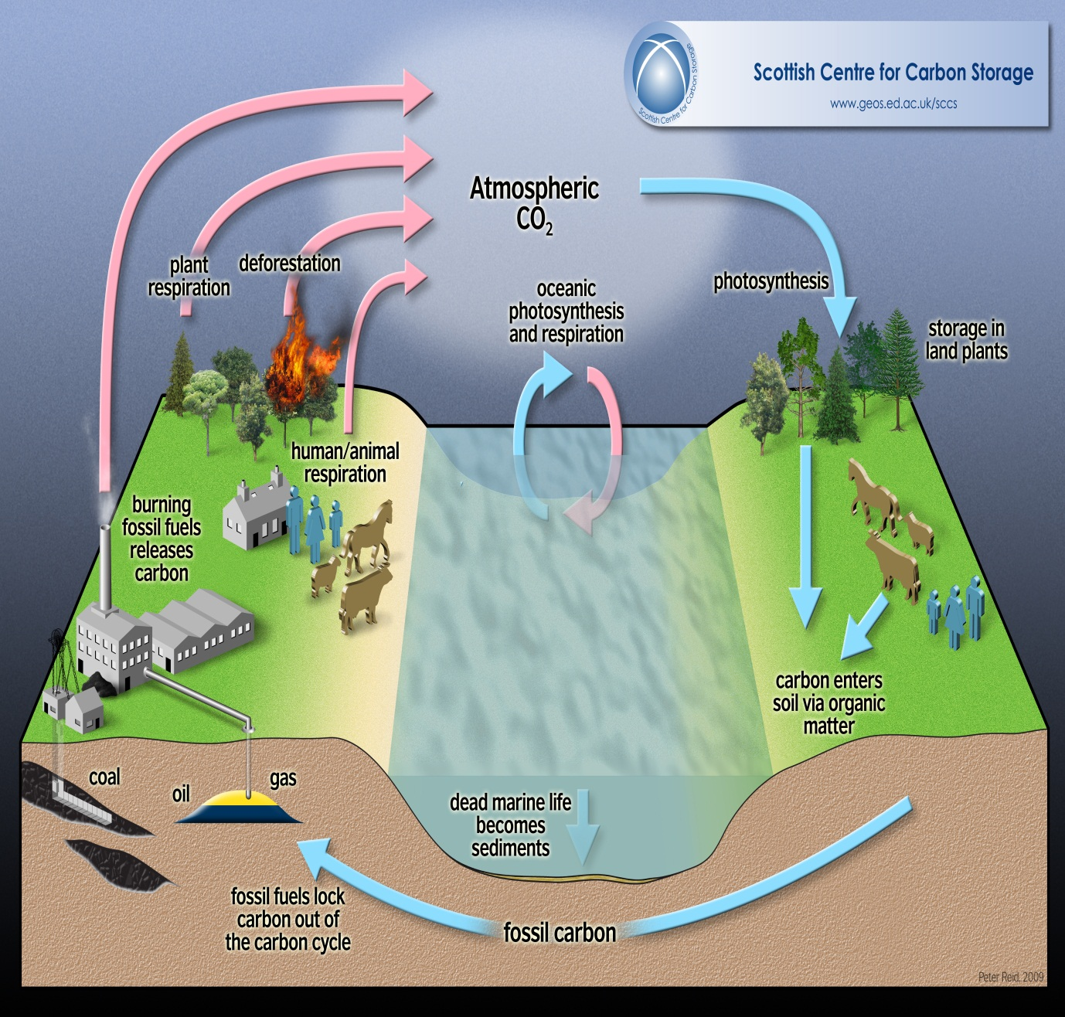
Carbon Cycle
What are the
2 main processes in the carbon cycle?

Slide 4
Carbon Cycle
Carbon (C) enters the biosphere during photosynthesis:
CO₂ + H₂O (carbon dioxide+ water)--->
C₆H₁₂O₆ + O₂ + H₂O(sugar+oxygen+water)
Carbon is returned to the biosphere in cellular respiration:
O₂ +H₂O + C₆H₁₂O₆ ---> CO₂ +H₂O + energy

Slide 5
Carbon Facts
Every year there is a measurable difference in the concentration of atmospheric CO₂ with changes in the seasons.
For example, in winter there is almost no photosynthesis ( higher CO₂ )
During the growing season there is a measurable difference in the concentration of atmospheric CO₂ over parts of each day.

Slide 6
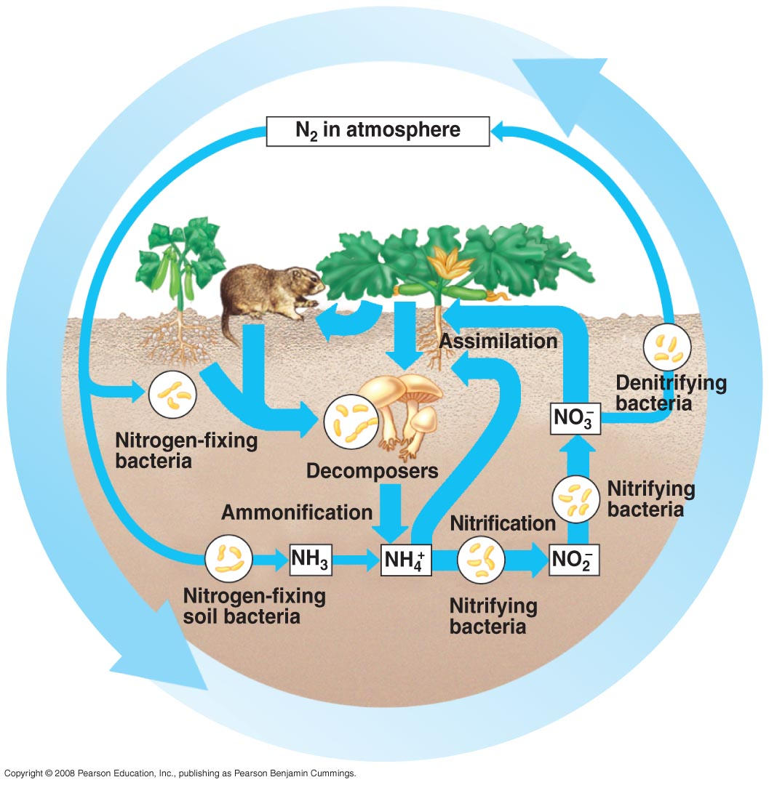
Nitrogen cycle

Slide 7
Nitrogen Facts
Nitrogen (N) is an essential constituent of protein, DNA, RNA, and chlorophyll.
Nitrogen is the most abundant gas in the atmosphere.
Nitrogen must be fixed or converted into a usable form.

Slide 8
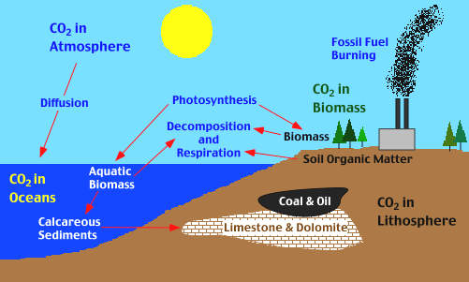
Oxygen Cycle (Photosynthesis)

Slide 9
Sources of Oxygen:
Photosynthesis and respiration
Photo disassociation of H₂O vapor
CO₂ and O₂ circulates freely throughout the biosphere.
Some CO₂ combines with Ca to form carbonates.
O₂ combines with nitrogen compounds to form nitrates.
O₂ combines with iron compounds to form ferric oxides.
O₂ in the troposphere is reduced to O3 (ozone).
Ground level O₃ (ozone) is a pollutant which damages lungs.

Slide 10
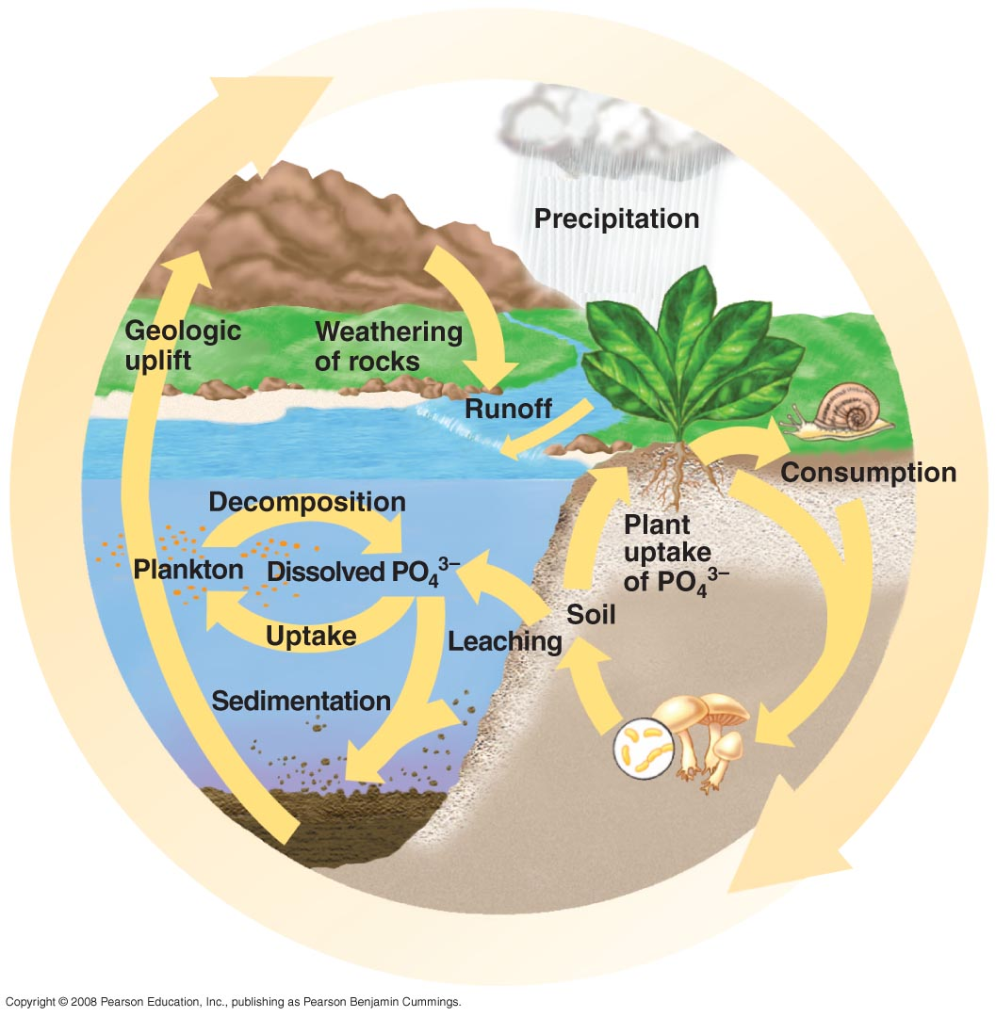
Phosphorus (P) Cycle

Slide 11
Phosphorus (P) Cycle
Component of DNA, RNA, ATP, proteins and enzymes
- Cycles in a sedimentary cycle
- A good example of how a mineral element becomes part of an organism.
- The source of Phosphorus (P) is rock.
- Phosphorus is released into the cycle through erosion or mining.
- Phosphorus is soluble in H2O as phosphate (PO4)
-Phosphorus is taken up by plant roots, then travels through food chains.
- It is returned to sediment

Slide 12
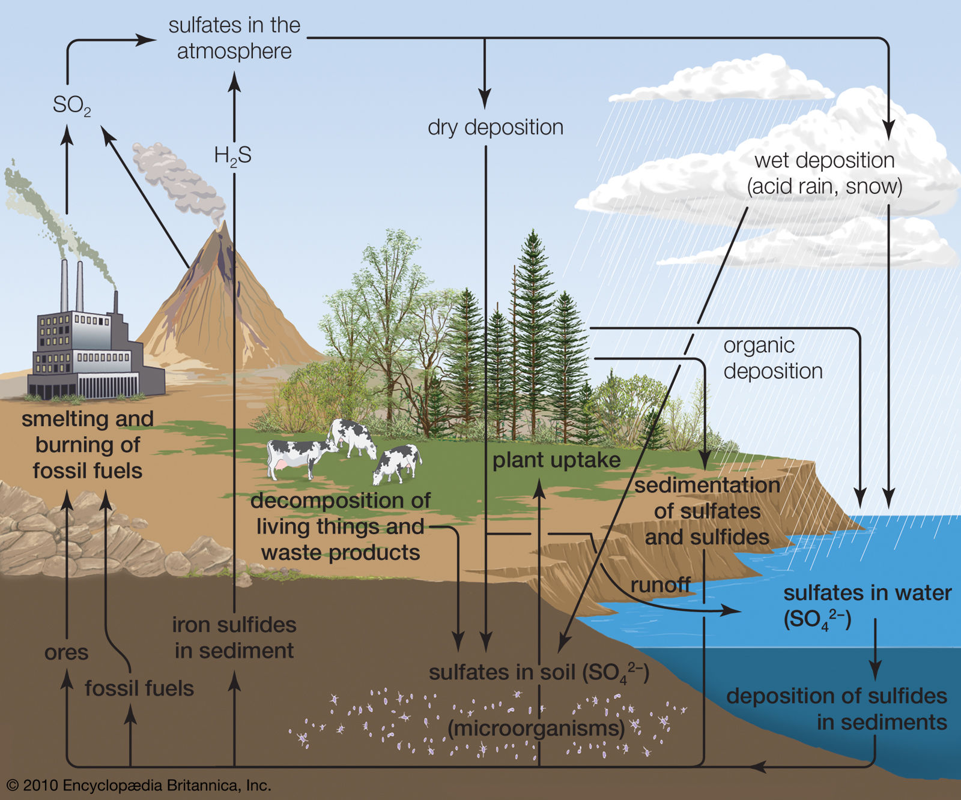

Slide 13
Sulfur (s) Cycle
Component of protein
Cycles in both a gas and sedimentary cycle.
The source of Sulfur is the lithosphere (earth's crust)
Sulfur (S) enters the atmosphere as hydrogen sulfide (H2S) during fossil fuel combustion, volcanic eruptions, gas exchange at ocean surfaces, and decomposition.
SO₂ and water vapor makes H₂SO₄ ( a weak sulfuric acid), which is then carried to Earth in rainfall.
Sulfur in soluble form is taken up by plant roots and incorporated into amino acids such as cysteine. It then travels through the food chain and is eventually released through decomposition.

Slide 14
Summary
The building blocks of life :Water ,Nitrogen, Carbon Dioxide, Phosphorus, Sulfur
Continually cycle through Earth's systems, the atmosphere, hydrosphere, biosphere, and lithosphere, on time scales that range from a few days to millions of years.
These cycles are called biogeochemical cycles, because they include a variety of biological, geological, and chemical processes.

